Slide 1

Healthcare Revenue Cycle Intelligence Studio
Demo
Prepared By
Desta Ensermu ( Data Analyst, Vibe Coder)

Slide 2
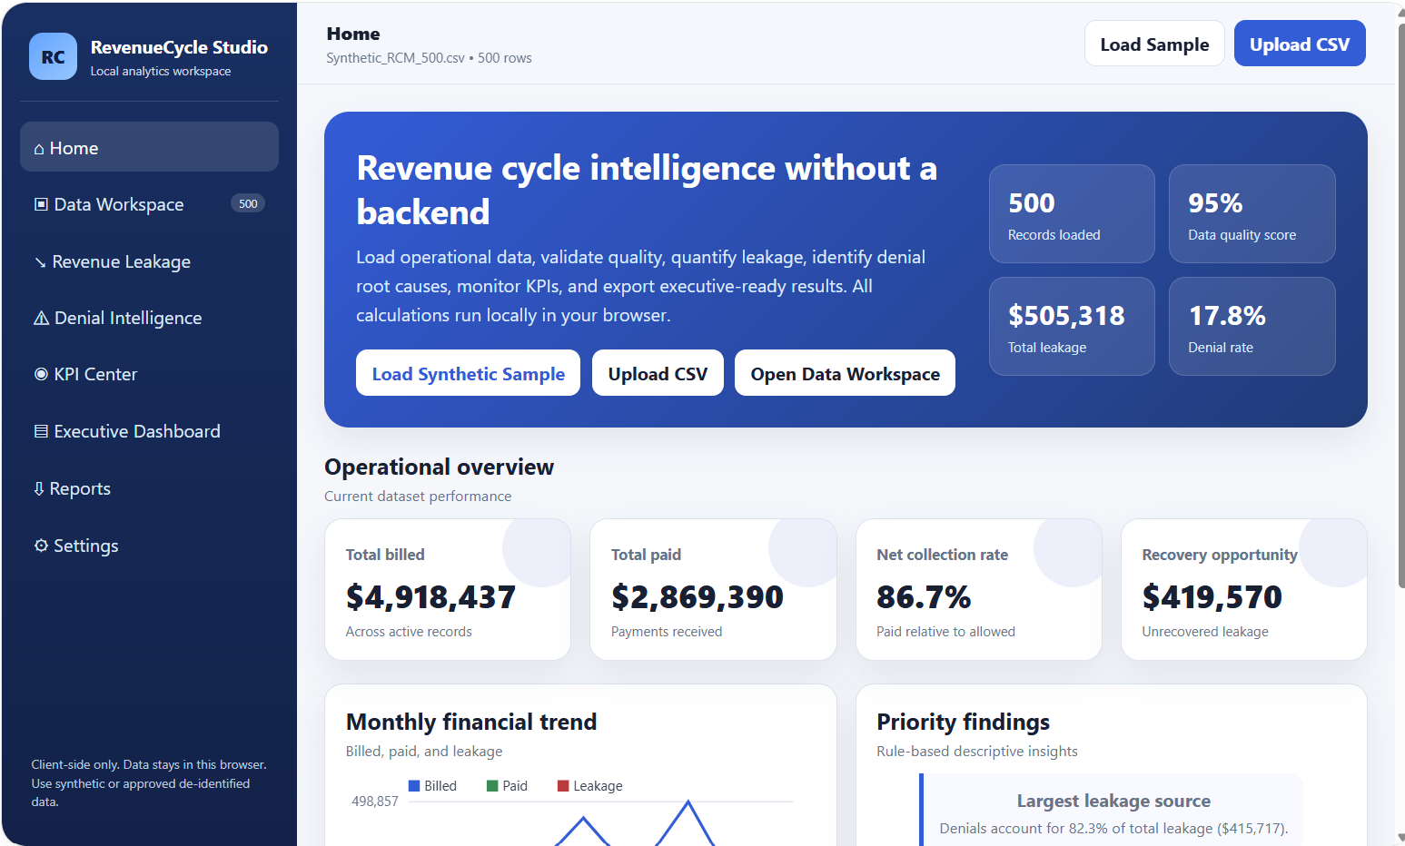
Product Preview

Slide 3
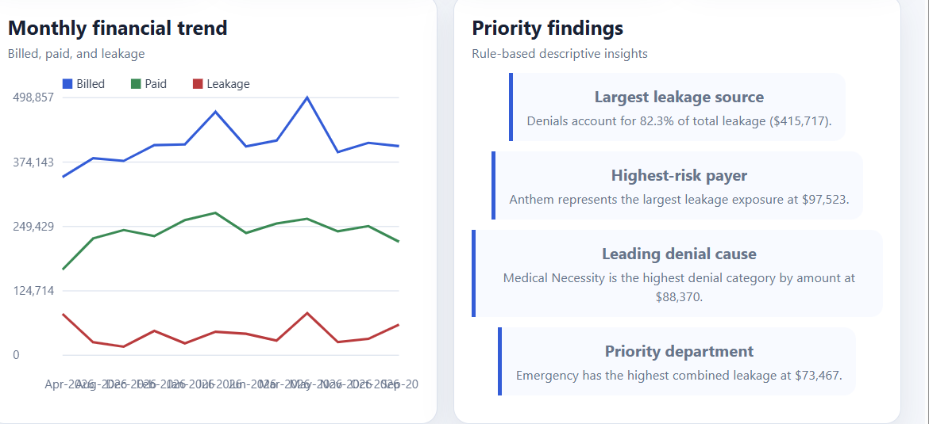
Trends and Findings

Slide 4
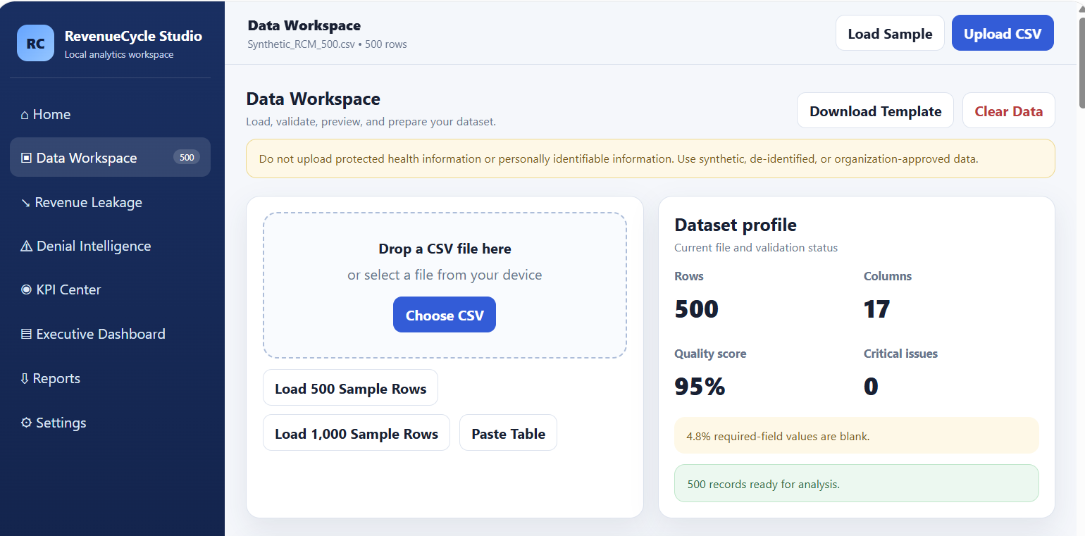
Dataset Profile

Slide 5
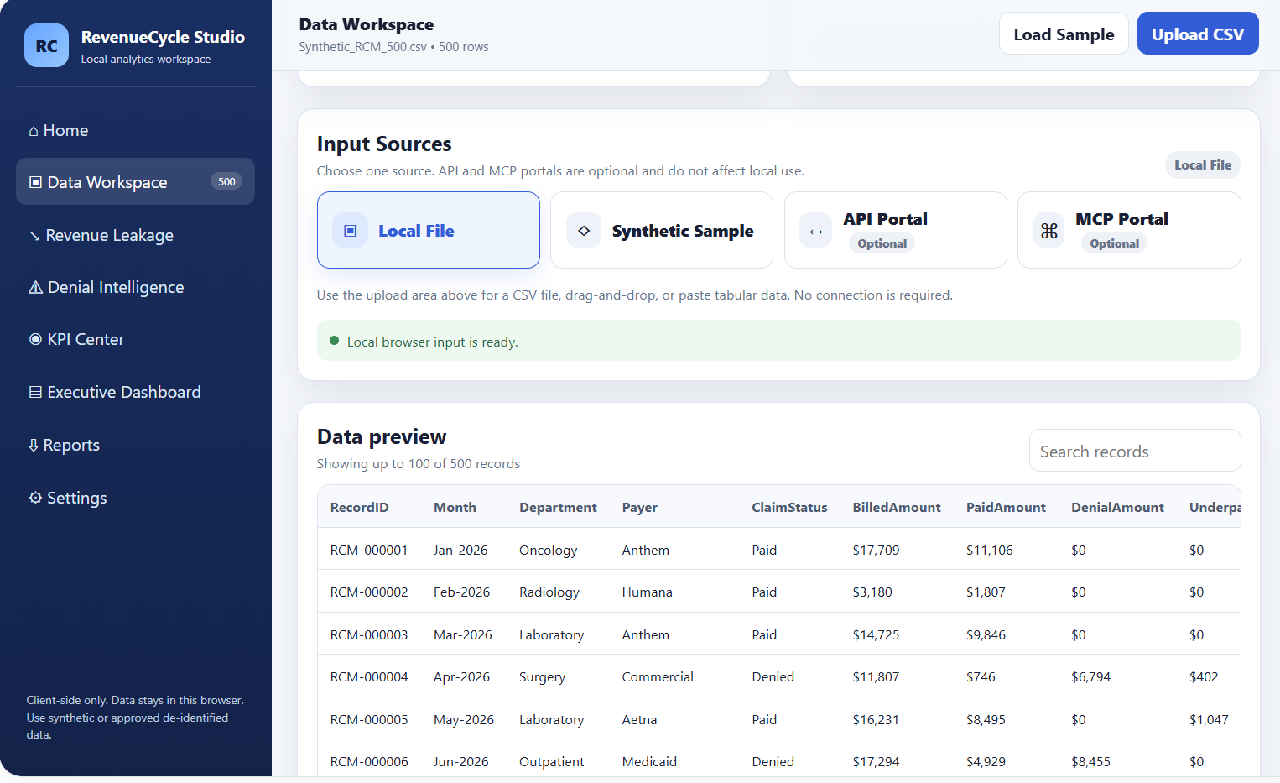
Data Workspace…

Slide 6
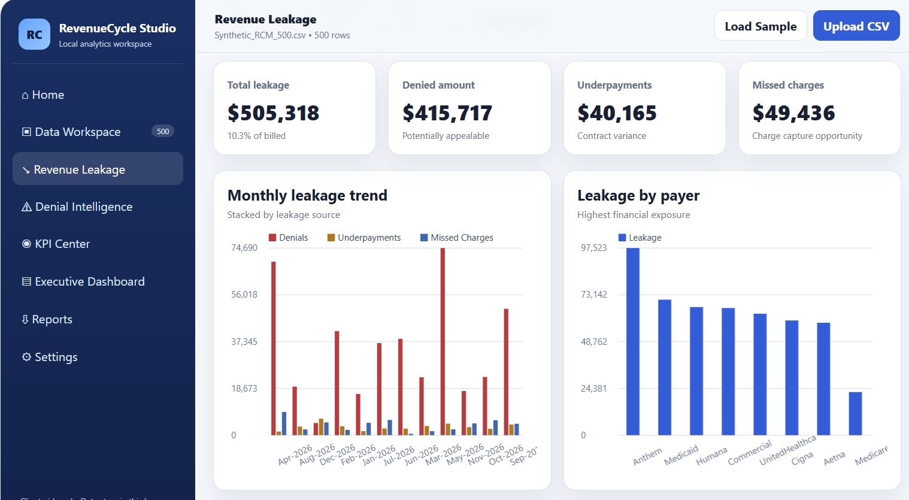
Revenue Leakage

Slide 7
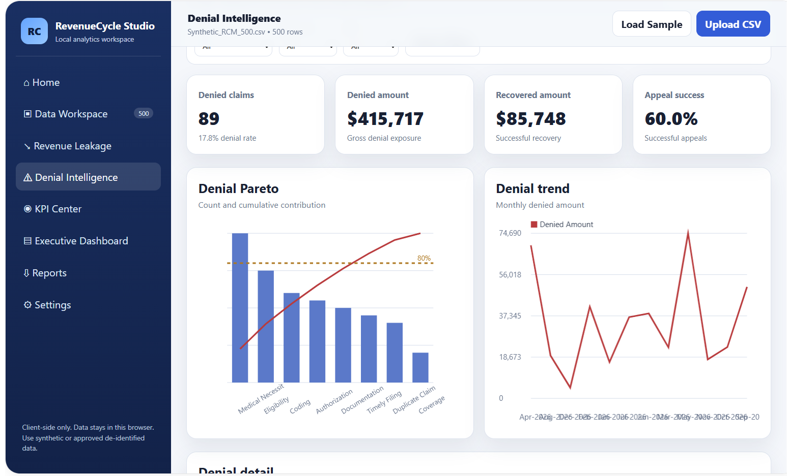
Denial Intelligence

Slide 8
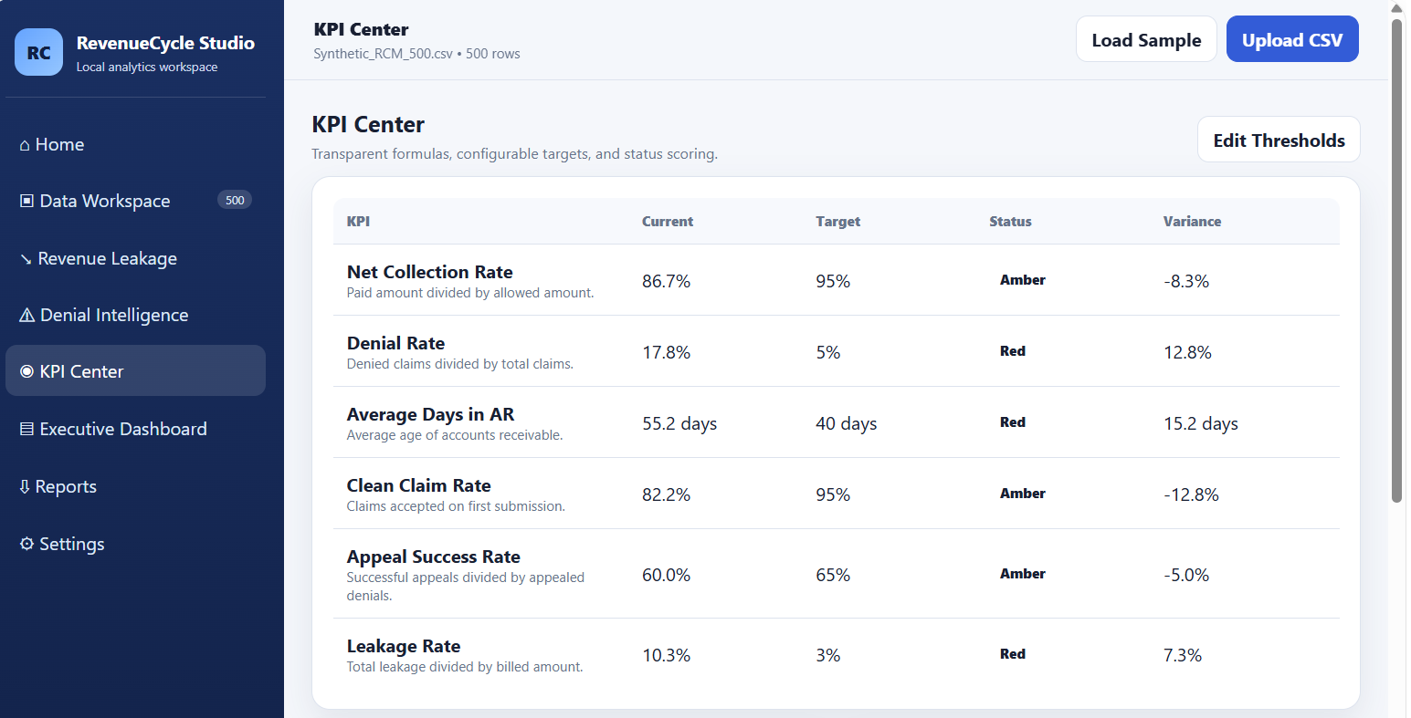
KPI Center

Slide 9
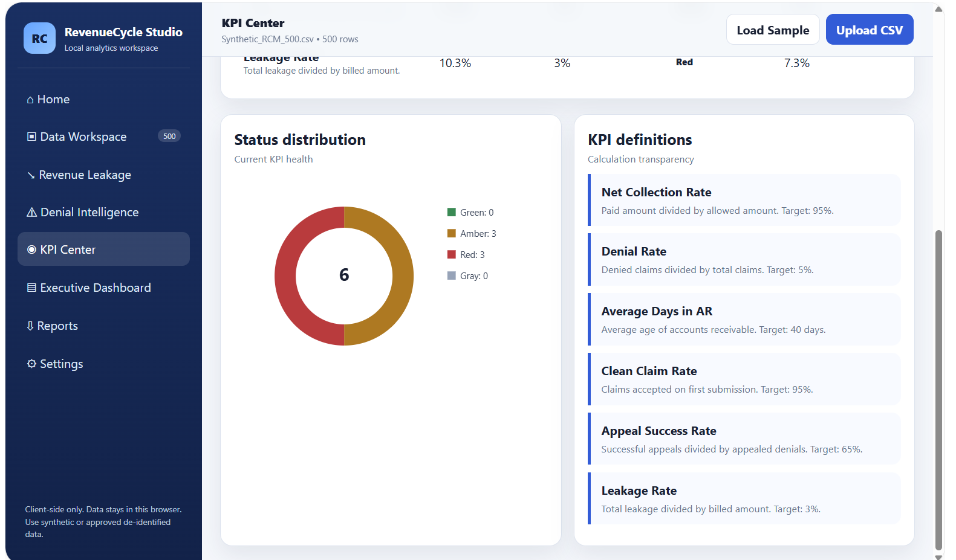
KPI Center- Status Distribution and definition

Slide 10
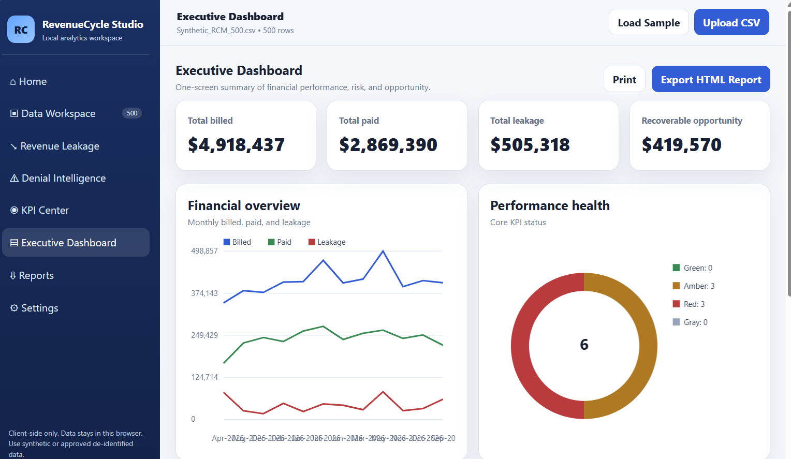
Executive Dashboard

Slide 11
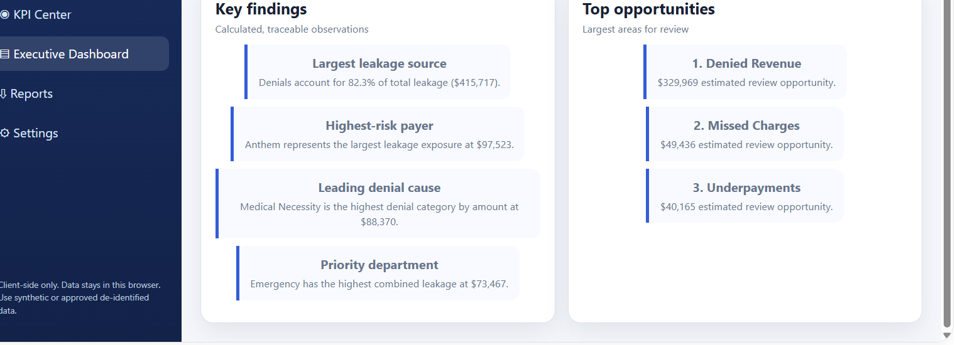
Key Findings and Top Opportunities

Slide 12
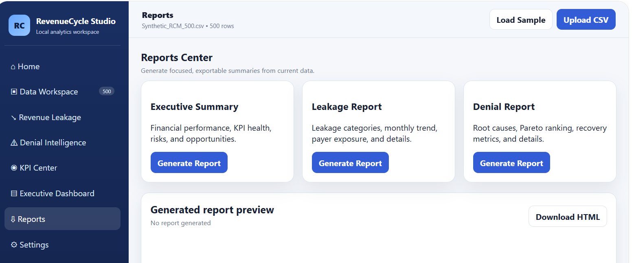
Report Center

Slide 13
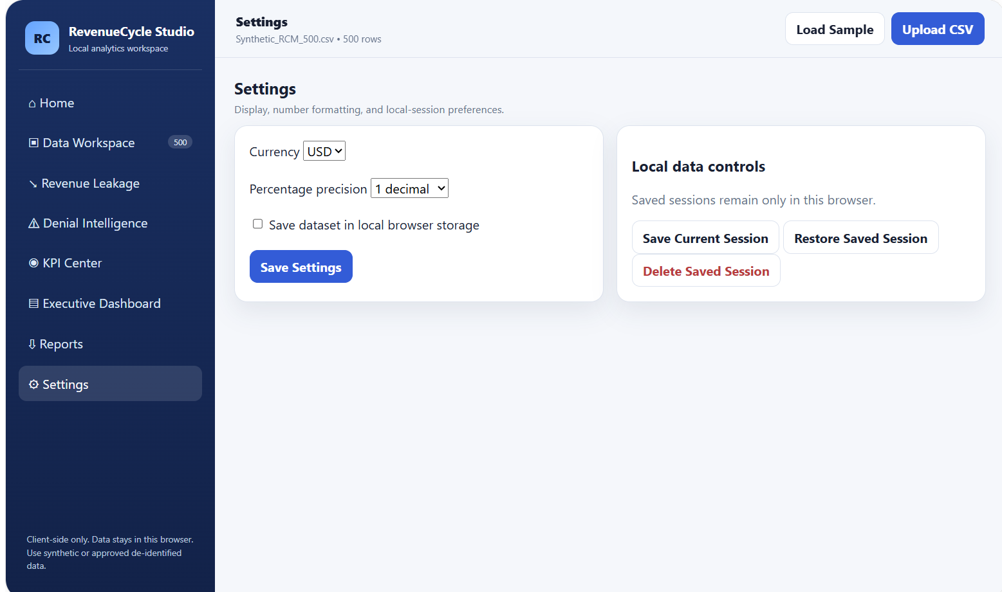
Settings

Slide 14
Acknowledgement
I am grateful to the OpenAI Team and collaborators for giving me this opportunity to participate in the Hackathon.
Thank You

